Slide 9
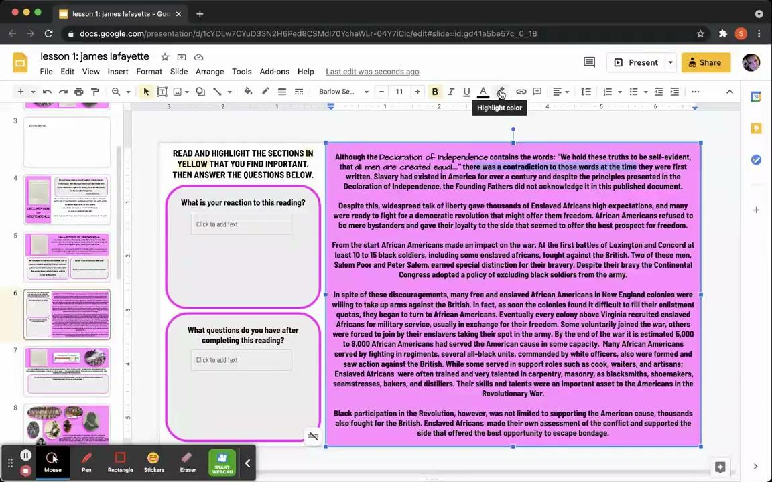
The Declaration of Independence and widespread talk of liberty provided thousands of Enslaved Africans high expectations, and many were ready to fight for a democratic revolution that might offer them freedom. African Americans refused to be mere bystanders and gave their loyalty to the side that seemed to offer the best prospect for freedom.
From the start African Americans made an impact on the war. At the first battles of Lexington and Concord at least 10 to 15 black soldiers, including some enslaved africans, fought against the British. Two of these men, Salem Poor and Peter Salem, earned special distinction for their bravery. Despite their bravy the Continental Congress adopted a policy of excluding black soldiers from the army.
In spite of these discouragements, many free and enslaved African Americans in New England colonies were still willing to take up arms against the British. In fact, as soon as the colonies found it difficult to fill their enlistment quotas, they began to turn to African Americans. Eventually every colony above Virginia recruited enslaved Africans for military service, usually in exchange for their freedom. Some voluntarily joined the war while others were forced to join by their enslavers taking their spot in the army. By the end of the war it is estimated 5,000 to 8,000 African Americans had served the American cause in some capacity. Many African Americans served by fighting in regiments. Several all-black units, commanded by white officers, also were formed and saw action against the British. While some served in support roles such as cooks, waiters, and artisans; Enslaved Africans were often trained and very talented in carpentry, masonry, as blacksmiths, shoemakers, seamstresses, bakers, and distillers. Their skills and talents were an important asset to the Americans in the Revolutionary War.
Black participation in the Revolution, however, was not limited to supporting the American cause. Thousands also fought for the British. Enslaved Africans made their own assessment of the conflict and supported the side that offered the best opportunity to escape bondage.

Slide 11
